Slide 1
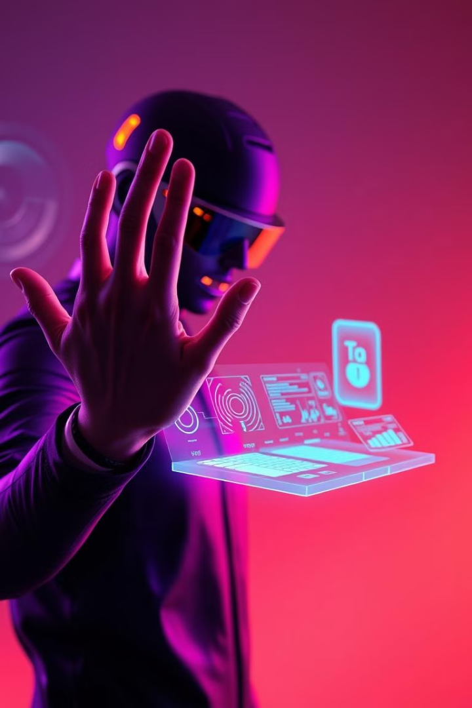
Visionary Control
(A GESTURE BASED SMART INTERACTION SYSTEM)

Slide 2
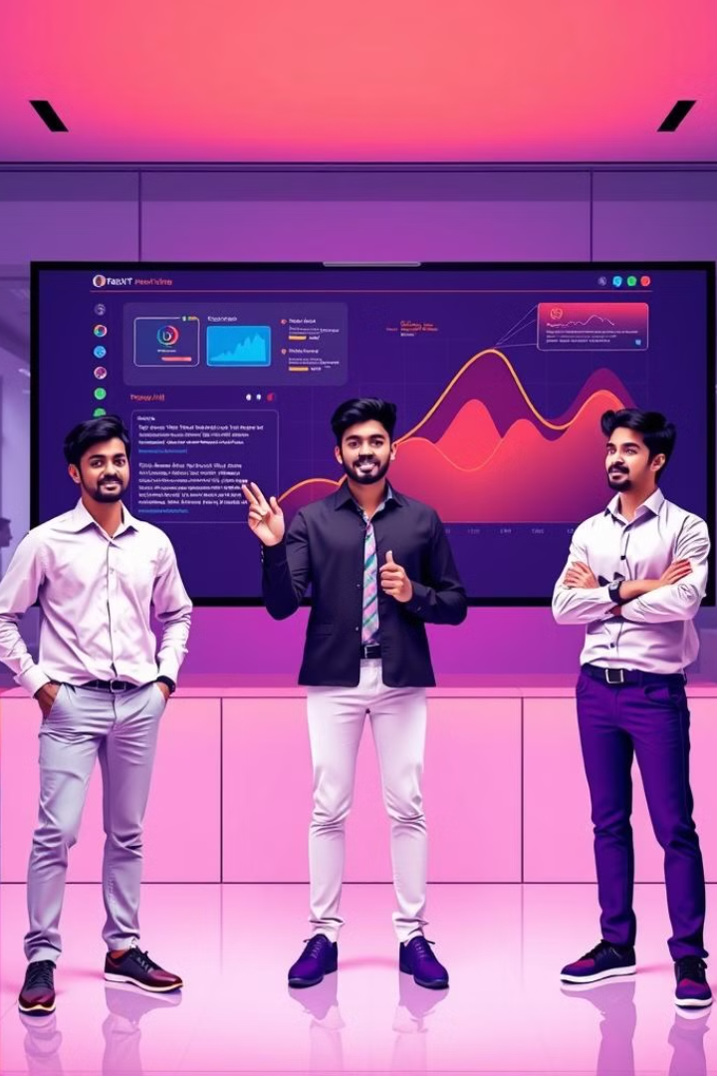
Presented by -
(Team Members)
1. Rachit Rai (2300910140046)
2. Anuj Gupta (2300910140008)
3. Shafa-At-Ali (2300910140059)

Slide 3

Introduction of Visionary Control
1
AI-Powered System
2
Touchless Interaction
Visionary Control is an AI-driven system that integrates hand gesture recognition and face authentication to control presentations and control media players Using Hand Gesture.
Provides a hygienic, intuitive, and interactive user experience, replacing traditional input methods with computer vision-based gesture control.
3
Reduces Manual Effort
Eliminates the need for keyboards, remotes, or physical contact. Perfect for scenarios requiring hands-free, accessible, or contactless operation.

Slide 4
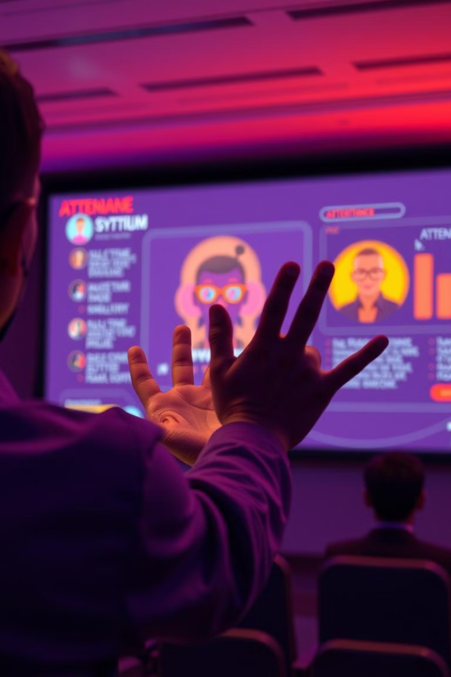
Aims
To develop a smart system that enables gesture-based control of media and presentations using hand gestures and face recognition, enhancing user interaction in a touch-free, intelligent, and efficient manner.
Objectives
Implement gesture-based slide navigation in presentations.
Allow face-based authentication to ensure only registered users can control the presentation.
Implement gesture-based media player controls without any face authentication for ease of access.
Provide modular control, enabling independent starting and stopping of Presentation and Media modules.
Improve real-time processing speed.
Integrate machine learning for accuracy in Face Recognition.
Provide an intuitive interface for real-world applications.

Slide 5
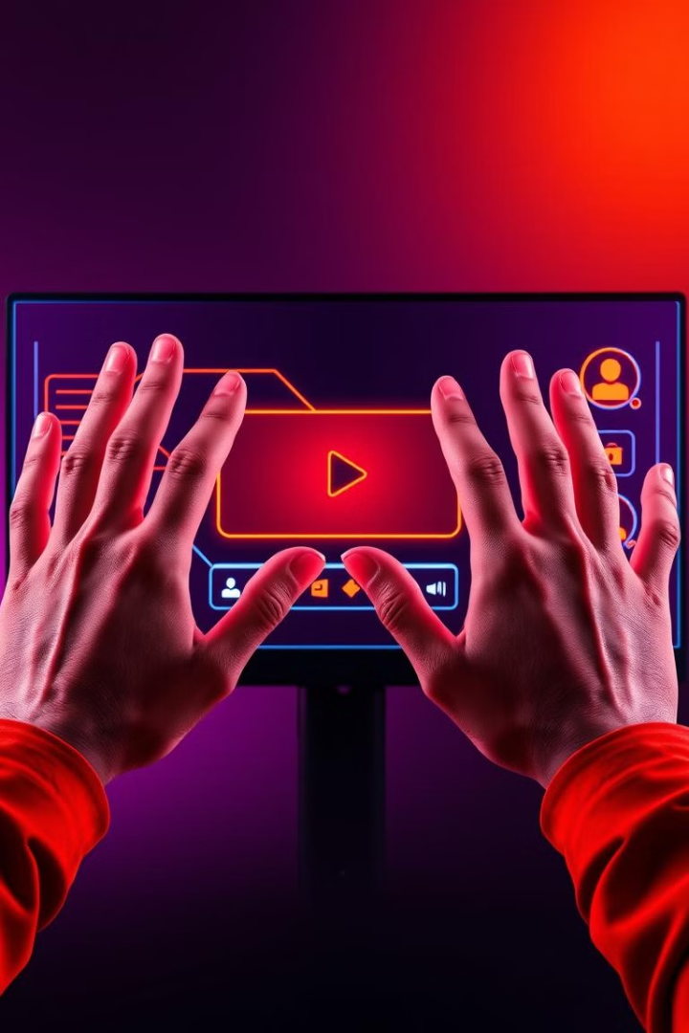


Key Features & Modules
Presentation Control
Media Player Control
Face Recognition Login/Registration
Gesture-based media control
Play/Pause,forward/backward, volume Up/Down.
Gesture-based navigation
Authentication required to control slides
Real-time video feed and hand tracking using OpenCV and MediaPipe
Upload and convert PPT to image slides

Slide 6
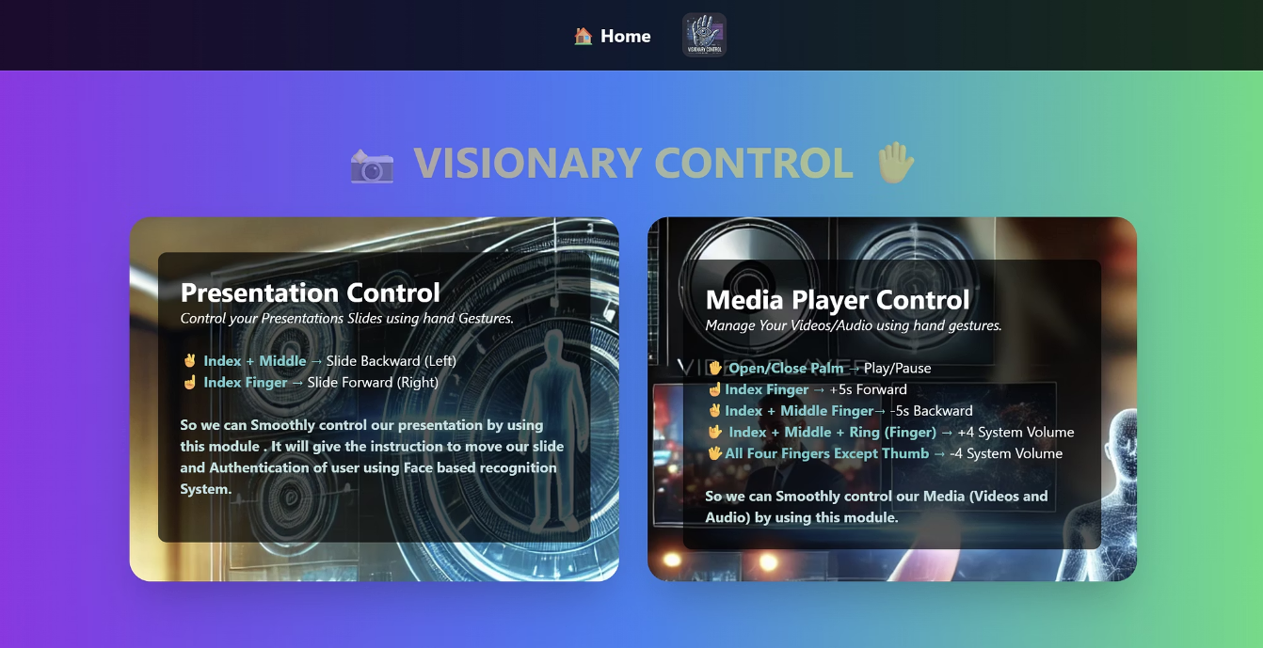
Project User Interface that includes 2 module in it.
Presentation Control Module (Face Recognition Based Login/Registration to provide Authentication for controlIing Slides)
Media Player Control Module:

Slide 7
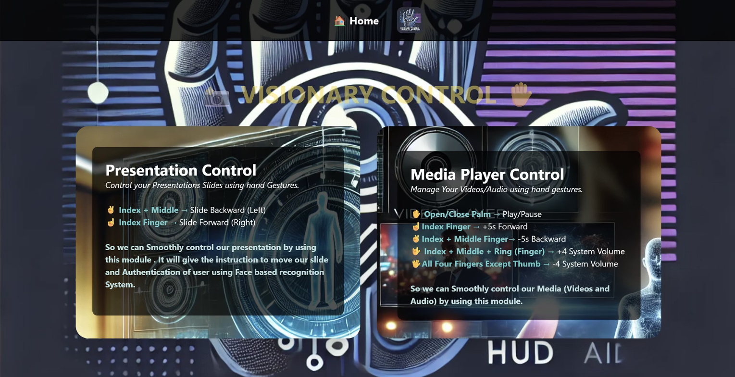
Project Interface 2nd

Slide 8
Technologies Used
Programming Language
Libraries & Frameworks
Python
OpenCV (Computer Vision)
Html
MediaPipe (Hand Tracking and Detecting 21 Points)
CSS
Base64 ,Pillow, Numpy
JavaScript
PyAutoGUI (Keyboard Automation like Media control automation)
Hardware Requirement
Flask (API Integration)
HD Webcam
PyWin32
Computer
face_recognition (Face Detection)
Pickle (Face data serialization)

Slide 9
Gesture Mapping
Presentation Control
✌️ Index + Middle Finger
Slide Backward
☝️ Index Finger
Slide Forward

Slide 10
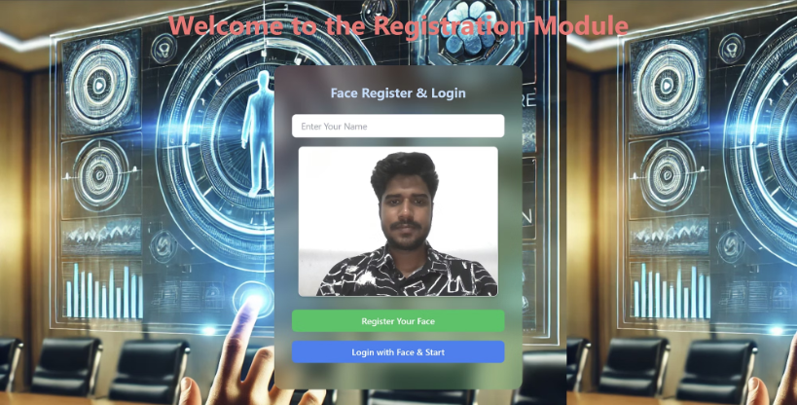
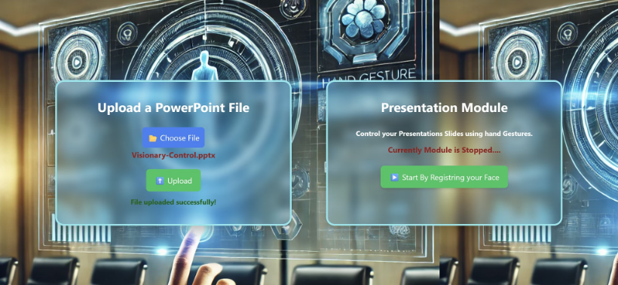
Presentation Control Snapshots
First Upload File Then Start Presentation after Registering your face
Register Your Face and then Login with Face

Slide 11
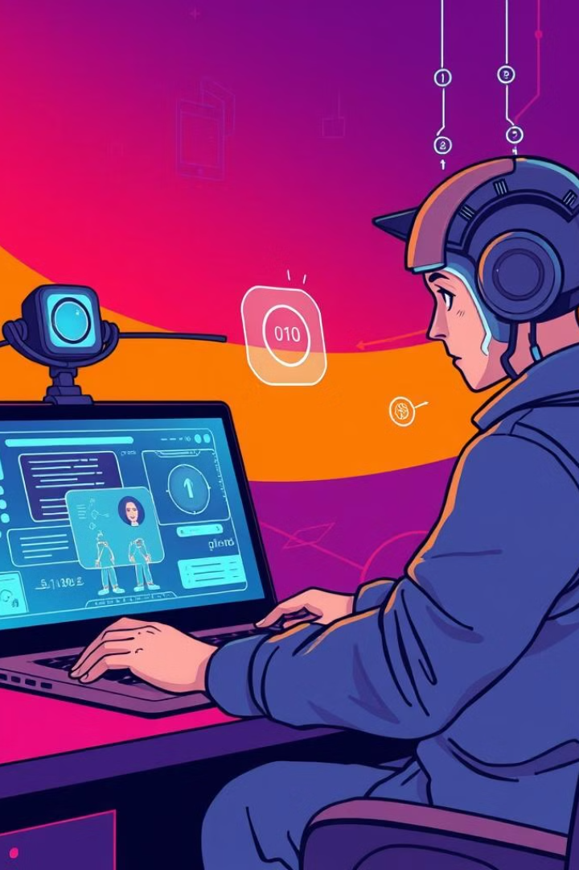
How Presentation Control Works?
On clicking Start, the system opens the Face-Based Authentication System.
Face Registration/Login Required before giving a presentation.
If the user is not registered, they must register first → then login.
Once logged in, the presentation page opens.
In real-time the system continuously matches the face of the logged-in user.
If the face mismatches, gesture control gets disabled.
Only the authenticated user's face can enable gesture-based slide control.
Slide control is secured to the authenticated user only.

Slide 12
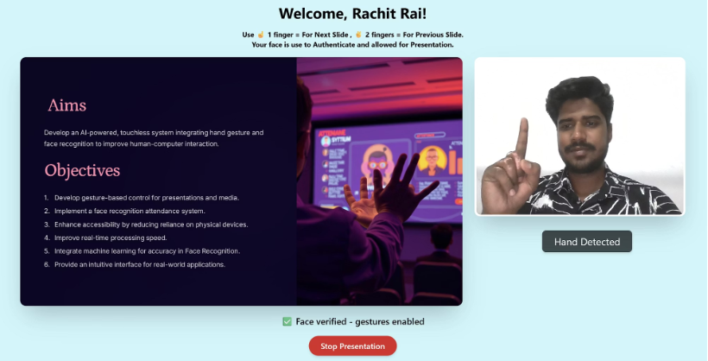
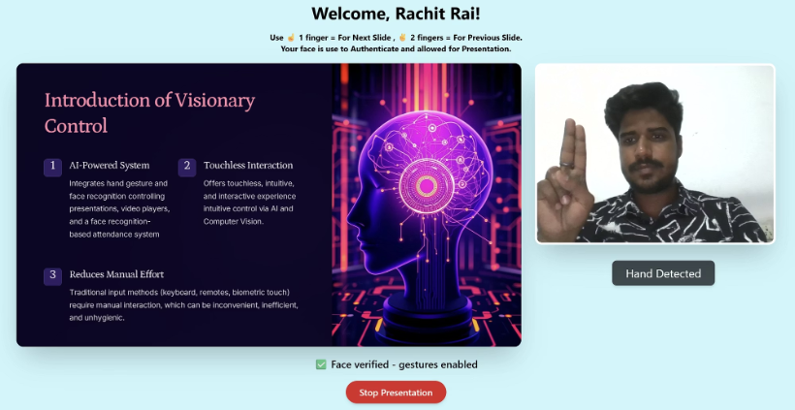
Presentation Control Snapshots

Slide 13

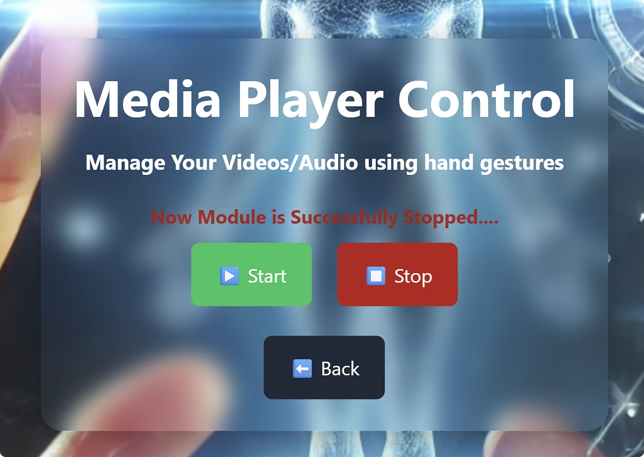
Gesture Mapping
Video Player Control
✋ Open/Close Palm
Play/Pause
☝️ Index Finger
+5s Forward
✌️ Index + Middle Finger
-5s Backward
🤟 Index + Middle + Ring
+4 Increase Volume
✋ All Four Fingers
-4 Decrease Volume

Slide 14
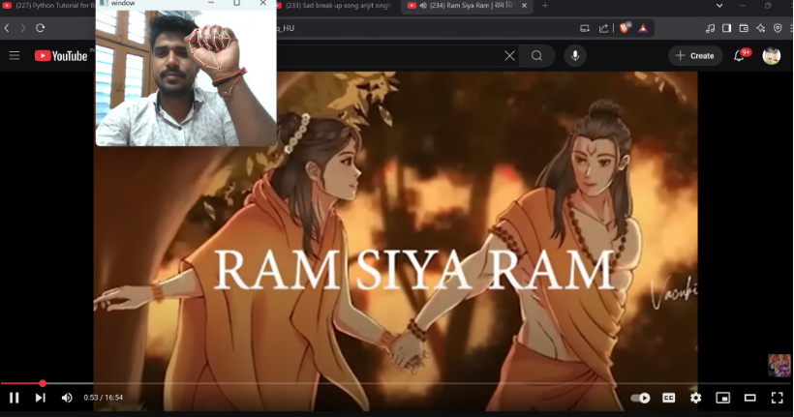
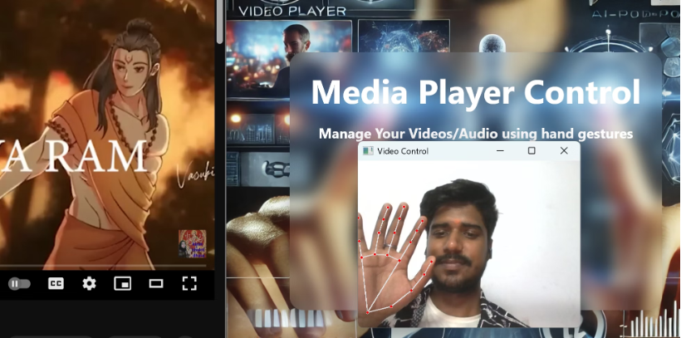
Video Control Snapshots

Slide 15
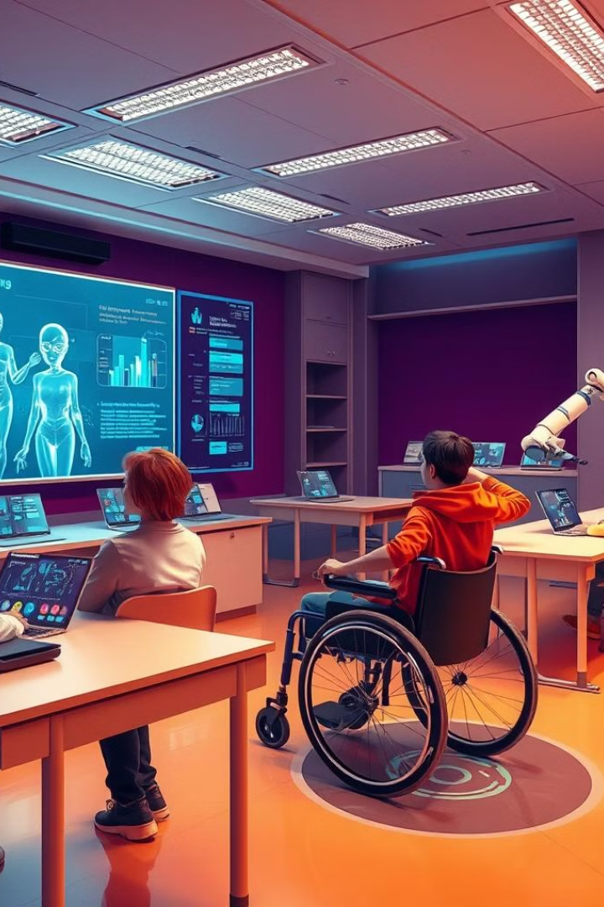
Real-Time Problem Solving
Eliminates the need for physical touch, reducing health risks (especially post-pandemic).
Reduces Manual Effort – Automates Presentation Control using Gesture and Secure Using Face based Authentication.
Enhances Accessibility – Helps users who can't operate traditional input devices
Increases Productivity – Provides a faster, intuitive user experience.

Slide 16
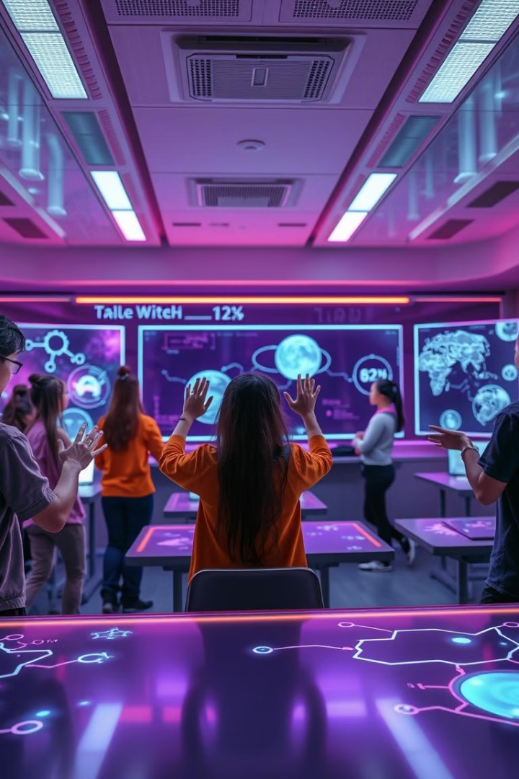
Project Scope and Real World Application
Smart Classrooms and Confrence Halls
Gesture based live video control, slide control in Seminar While Discussing Important topics
Corporate Offices
Hands-free Power-Point Presentations and Meetings.
Gaming & VR
Gesture-based controls enhance immersion.
Home Automation
Future extension for gesture-based smart home controls.
Media Rooms/Home Theaters
Gesture-based control for media playback

Slide 17
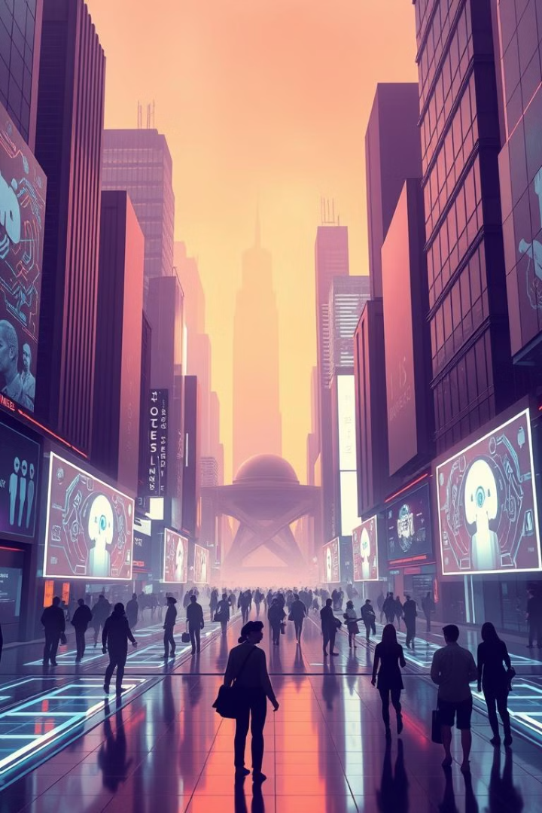
Future Enhancements
1
IoT Integration
Smart home controls , Smart TVs.
2
AR/VR Interaction
Gaming and simulations.
3
Advanced AI Models
AI-based gesture training for custom gestures. It provides Higher accuracy
4
Voice Command
Hybrid control system using Speech Recognition.

Slide 18
Conclusion
Visionary Control enhances HCI through intuitive gestures & face recognition.
A step towards touchless technology with vast real-world applications.
The project has significant potential for real-world implementation in various domains.
Visionary Control bridges the gap between humans and machines using intuitive vision-based interfaces.
By eliminating physical touch, it paves the way for futuristic, inclusive, and smart control systems.
Thank You!

